Slide 1
Comprehensive Analysis of Crop Yield, Soil, and Irrigation
Insights for Optimized Agricultural Practices
Name - Sumit Baviskar
Date - 3 October 2024

Slide 2
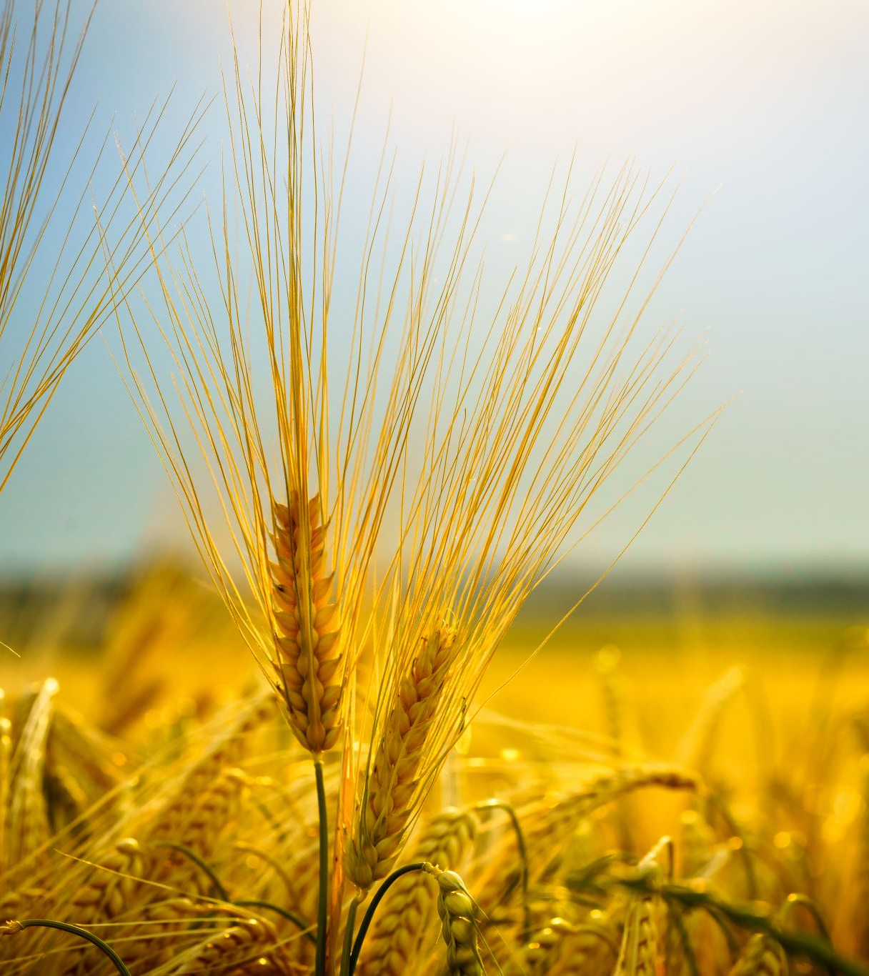
Overview
Objective:
To analyze factors affecting crop yield.
To provide actionable insights for better resource management.
Key Focus Areas:
Region-wise yield analysis.
Soil type influence on crop productivity.
Impact of irrigation and fertilizer on yield.
Weather and rainfall effects on yield.

Slide 3
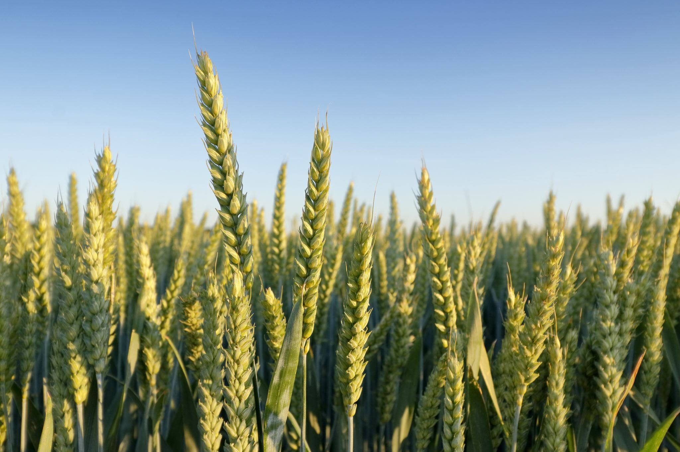
Region-Wise Yield Analysis
Insights:
North Region has the highest yields, especially for Barley and Cotton.
East and South Regions show lower median yields for crops like Soybean and Rice.
West Region has consistent but slightly lower yields for crops like Maize and Wheat.
Actionable Recommendations:
Focus on improving agricultural practices in East and South Regions.
Share best practices from North Region for higher yields.

Slide 4
Soil Type Influence on Yield
Key Observations:
Loam Soil: Best yields across all regions and crops.
Peaty Soil: High yields for Cotton, Rice, and Wheat.
Sandy Soil: Performs well for Barley and Cotton but varies for other crops.
Chalky Soil: Lower yields overall.
Silt Soil: Stable but medium-range yields.
Recommendations:
Promote crop rotation strategies with Loam Soil.
Use Peaty Soil for water-intensive crops like Rice.

Slide 5
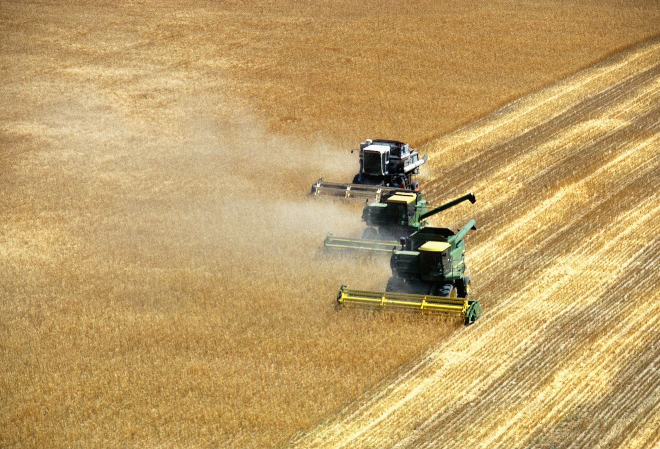
Crop-Specific Insights
Observations by Crop:
Barley: High yields in Loam and Sandy soils.
Cotton: Best performance in Loam and Peaty soils.
Maize: High yields in Sandy soil (East Region).
Rice: Better yields in Peaty and Loam soils.
Soybean: Consistent but lower yields.
Wheat: Optimal yields in Loam and Peaty soils.
Recommendations:
Match crops with suitable soil types for maximum productivity.

Slide 6
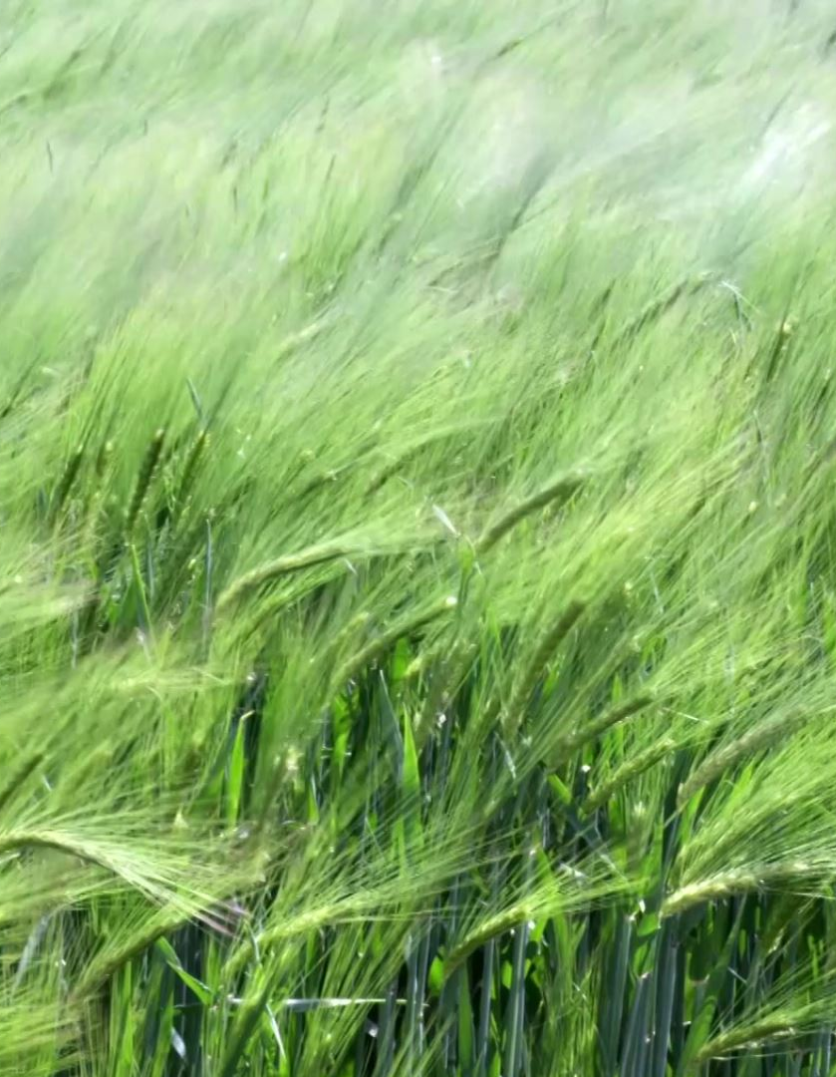
Impact of Fertilizer and Irrigation
Key Findings:
Fertilizer reduces days to harvest for all crops, especially Barley and Cotton.
Irrigation significantly boosts yield, especially in sunny conditions.
Combined use of fertilizer and irrigation maximizes yield and reduces variability.
Recommendations:
Prioritize fertilizer and irrigation for crops like Maize, Cotton, Rice, and Soybean.
Develop policies to encourage combined resource use.

Slide 7

Weather and Yield Relationship
Observations:
Cloudy Weather: Fertilizer improves yield from 4 to 6 tons/ha.
Rainy Weather: Fertilizer use shows smaller yield differences due to natural rainfall benefits.
Sunny Weather: Largest improvement with irrigation and fertilizer combined.
Recommendations:
Focus on irrigation during sunny weather to stabilize yields.
Use fertilizer consistently, especially in cloudy and sunny conditions.

Slide 8

Rainfall and Fertilizer Interaction
Insights:
Higher rainfall increases yield, especially with fertilizer use.
Without fertilizer, yield potential is capped even with sufficient rainfall.
Recommendations:
Optimize rainfall and fertilizer usage to maximize yield.
Plan irrigation systems to complement natural rainfall patterns.

Slide 9
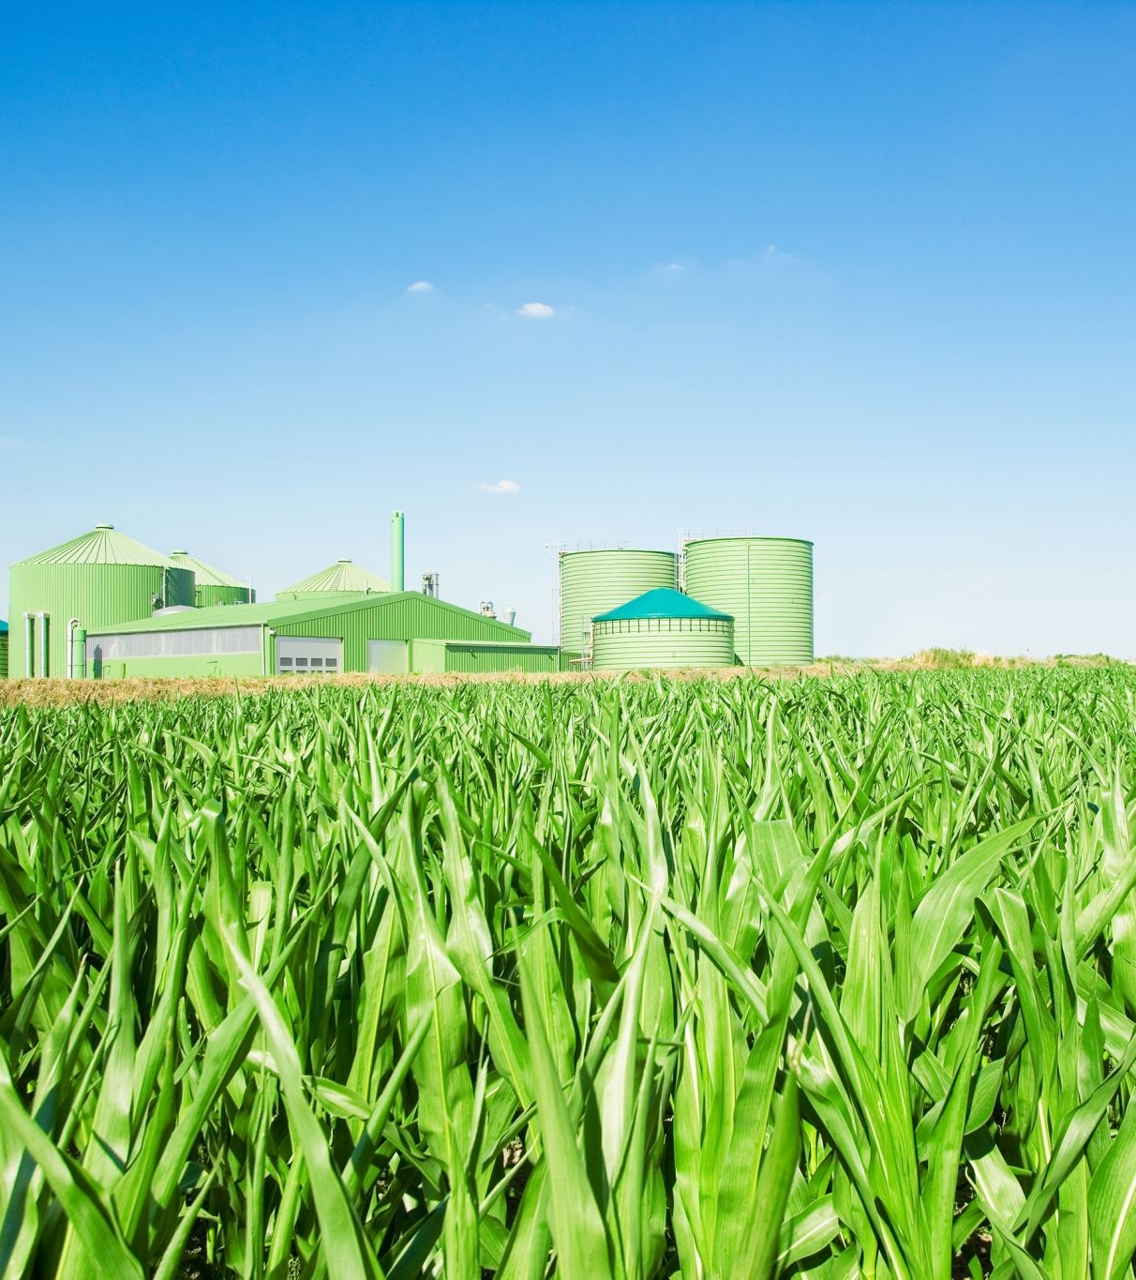
Final Conclusions
Key Takeaways:
Fertilizer and irrigation are critical for improving yields.
Loam and Peaty soils are most productive.
Weather and rainfall management are essential for consistent crop performance.
Strategic Recommendations:
Invest in irrigation infrastructure and fertilizer programs.
Match crop types with suitable soils and regions.
Develop regional agricultural policies based on insights.

Slide 10

Thank You!
Questions and Discussions
Contact:
Sumit Baviskar
st.baviskar43@gmail.com
https://www.linkedin.com/in/sumit-baviskar/

